Slide 1
Unit -1 Information Assets and Threats
CSE3501 Information Security Analysis and Audit

Slide 2
Outline
CIA Triad
Threats to Information Assets
Threat Classification
Types of Attacks
Types of Virus
Types of Worms
Types of Trojans
Other Security Threats
Network Attacks
Types of Network Attacks
Spoofing
DoS Attacks
Bluetooth Related Attacks
Common Vulnerability and Exposures

Slide 3
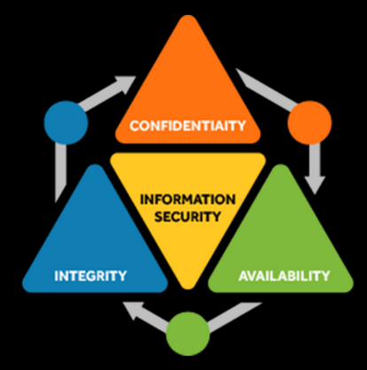
CIA Triad
https://www.youtube.com/watch?v=rwigKjEsdTc
https://www.youtube.com/watch?v=szcmb-lcYV4

Slide 4
Confidentiality
Data confidentiality is most important thing in computer security. Data or information should send from right party to right receiver without any interruption, falsifies or any other harmful things. We can divide data confidentiality for two sectors.
Data Confidentiality – Only authorized individuals only can read the data or information.
Privacy – Personal data that influence or control person or party restrict for unauthorized party.

Slide 5
Confidentiality Examples
High Confidentiality
Data of Ministry of defense are high confidential requirement.it may cause big risk to civil people if them hand down to wrong people or party.
Data of Mobile Operator Company are high confidential requirement. Leak or disclosed them make big attack to the privacy of the individuals.
Moderate Confidentiality
Data of bank account holder are moderate confidential requirement. Disclosed them make difficulties for the account holder and it affect to trade mark of the bank
Low Confidentiality
Personal data of the employee in company are the low confidentiality requirement. It make minor damage to employee or company.
Income of the company or person is low confidentiality requirement.

Slide 6
Integrity
It should be that the integrity of data. Data or information should read only specified person or party that they planned before. Only authorized party can modify or remove the data under the legal system that they confirmed early. There are two related concepts.
Data integrity – Data or information can change only specialized type and specialized person(s) or party
System integrity – System work on its own way that it planned before without any unauthorized manipulation. We can’t change the procedure of system that we necessary.

Slide 7
Integrity Examples
High Integrity
Data of the Central Bank are high integrity requirement. Fallacy data cause to corrupt decision.
Data of the Department of motor traffic are also high integrity requirement.
Patient’s data in hospital are also high integrity requirement. Wrong data affect very seriously for patients. It may cause death or life treating damages.
Moderate Integrity
Data shows in ATM are moderate integrity requirement. All machines and any time of we check ,it should display the correct data. Fallacy data make big troubles for the customers.
Enrollment data of university student are also moderate integrity requirement.
Income of the organization are also moderate integrity requirement.
Low Integrity
Data in social web sites are low integrity requirement.
Data in online mobile number directories are low integrity requirement.
Website that provide technical information and specification of mobile phone and vehicle are low integrity requirement. Sometimes it provide inaccurate data

Slide 8
Availability
Can use system without any interrupt. Service is not denied to authorized users.
There are three level that describe the influence to person, party or organization who faced with security collapse.
A) Low – Make limited loss for Organization name, asset and perform. Minor damage to Confidentiality , Integrity and Availability. Affect is minor to organization operational level, perform, organization asset, financial lost and minor harm for individuals.
B) Moderate – Significantly affect for Organization name, asset and perform. Damage to Confidentiality , Integrity and Availability is significant. Affect Significant to organization operational level, perform, organization asset, financial lost and Significant harm for individuals. Duration to perform single function will be increase . But no injuries, life treating injuries or death.
C) High – Seriously affect for Organization name, asset and perform. Damage to Confidentiality, Integrity and Availability is very high. Affect Seriously to organization operational level, perform, organization asset, financial lost and Seriously harm for individuals. One or more functions will be stop. May be Injuries, life treating injuries or death.

Slide 9
Availability Examples
High Availability
Website of the department of examination is high availability requirement. Anyone can check exam result when it release without any interruption or breakdown.
Moderate Availability
Website of a university is moderate availability requirement. Unavailable it make big difficulties to the client.
Website of Railway department is moderate availability requirement. If someone want to check fees of ticket or timetable any time it should be available.
Low Availability
Website of online mobile directories are low availability requirement.
Online lottery result lookup application also low availability requirement.

Slide 10
Threats to Information Assets
Risk is the potential threat, and process of understanding and responding to factors that may lead to
a failure in the confidentiality, integrity or availability of an information system constitute risk management. The key concerns in information assets security are:
theft
fraud/ forgery
unauthorized information access
interception or modification of data and data management systems

Slide 11
Key Vocabularies
Threat
Vulnerability
Threat Agent or Actor
Threat Vector
Threat Targets

Slide 12
Threat
Any circumstance or event with the potential to adversely impact organizational operations (including mission, functions, image or reputation), organizational assets or individuals through an information system via unauthorized access, destruction, disclosure, modification of information and / or denial of service. Also potential for a threat source to successfully exploit a particular information system vulnerability - NIST.
Examples
Malware
Power outage
Social Engineering
Intruder
Tsunami

Slide 13
Vulnerability
A weakness in design, implementation, operation or internal control – ISACA
Examples:
Unpatched Systems
Lack of antivirus software
Weak passwords
Unlocked doors

Slide 14
Threat Agent
the intent and method targeted at the intentional exploitation of the vulnerability or a situation and method that may accidentally trigger the vulnerability
Examples:
Non-Target specific: Non-Target specific threat agents are computer viruses, worms, Trojans and logic bombs.
Employees: staff, contractors, operational/ maintenance personnel or security guards who are annoyed with the company.
Organized crime and criminals: criminals target information that is of value to them, such as bank accounts, credit cards or intellectual property that can be converted into money. Criminals will often make use of insiders to help them.
Corporations: corporations are engaged in offensive information warfare or competitive intelligence. Partners and competitors come under this category.
Unintentional human error: accidents, carelessness etc.
Intentional human error: insider, outsider etc.
Natural: Flood, fire, lightning, meteor, earthquakes etc.

Slide 15
Threat Vector & Target
Threat Vector - is a path or a tool that a threat actor uses to attack the target.
‘Threat targets’ are anything of value to the threat actor such as PC, laptop, PDA, tablet, mobile phone, online bank account or identity.

Slide 16
Virus
Virus is a malicious program able to inject its code into other programs/ applications or data files and the targeted areas become "infected".
Installation of a virus is done without user's consent, and spreads in form of executable code transferred from one host to another.
Types of viruses include Resident virus , non-resident virus; boot sector virus; macro virus; file-infecting virus (fileinfector); Polymorphic virus; Metamorphic virus; Stealth virus; Companion virus and Cavity virus.

Slide 17
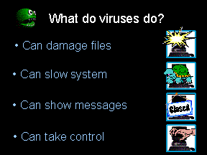
Signs Your Computer is Infected
Functions slower than normal
Responds slowly and freezes often
Restarts itself often
See uncommon error messages, distorted menus, and dialog boxes
Notice applications fail to work correctly
Fail to print correctly

Slide 18
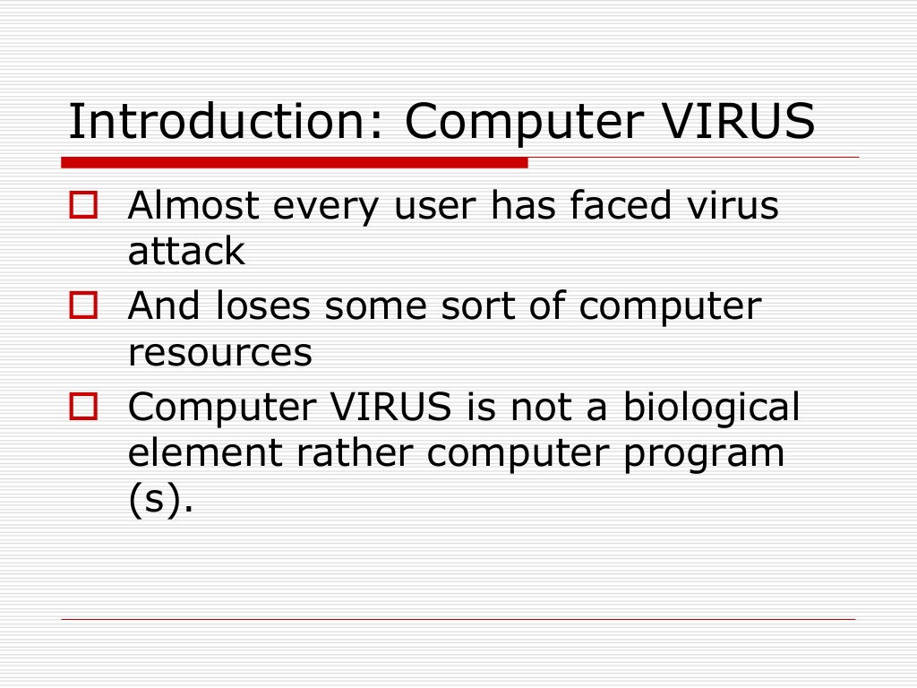
Introduction

Slide 19
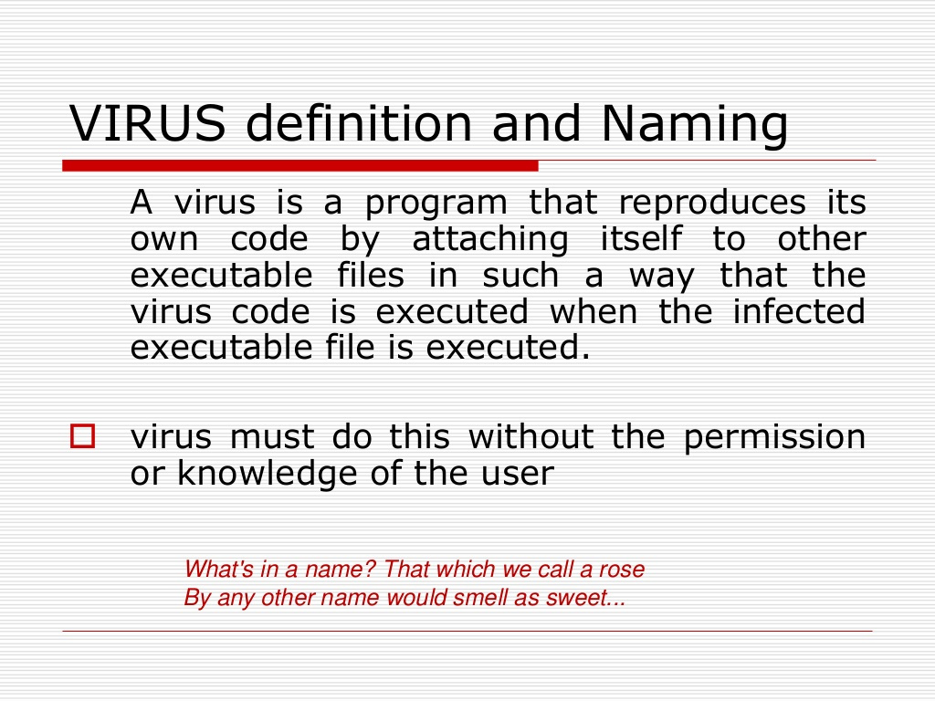
VIRUS Definition and Naming

Slide 20
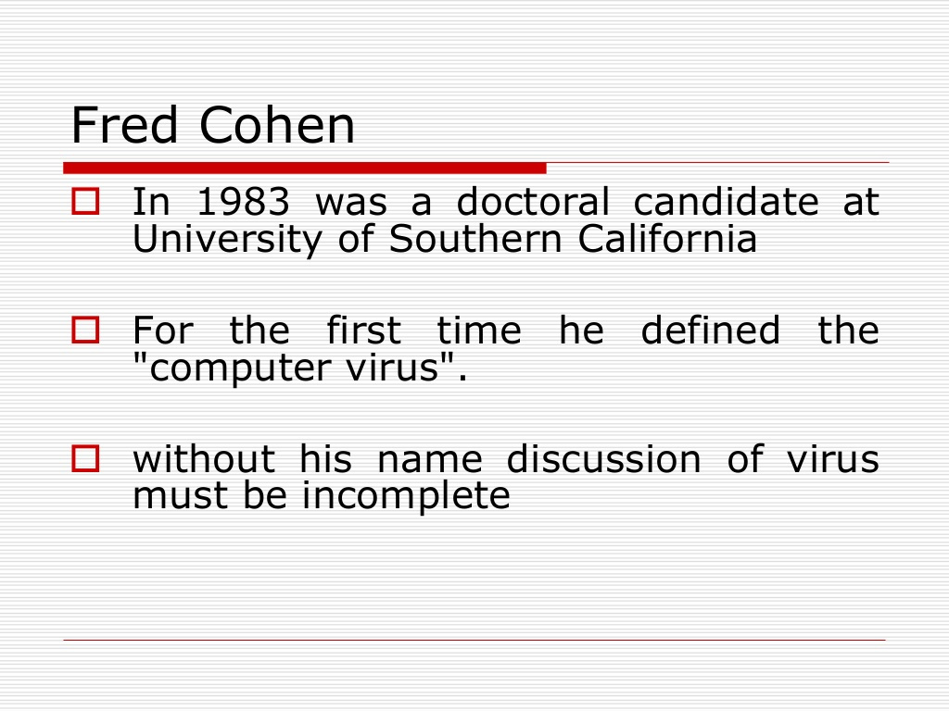
Fren Cohen

Slide 21
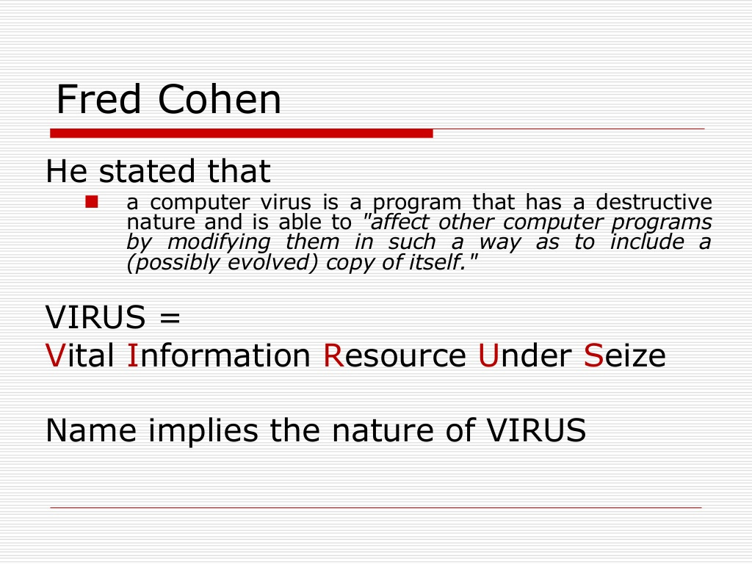
Frem Cohen

Slide 22
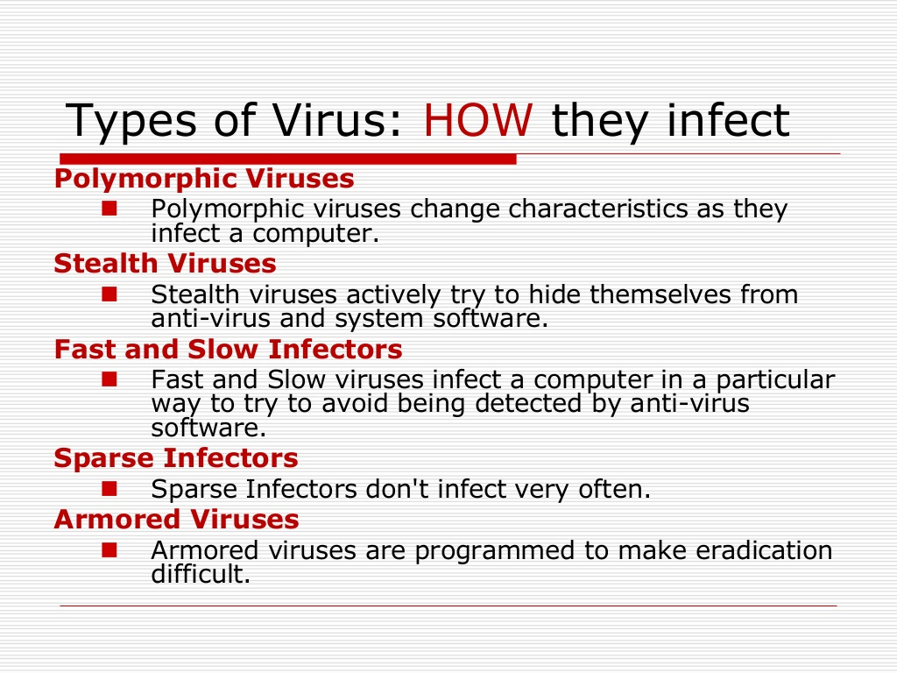
Types of VIRUS : How they infect

Slide 23
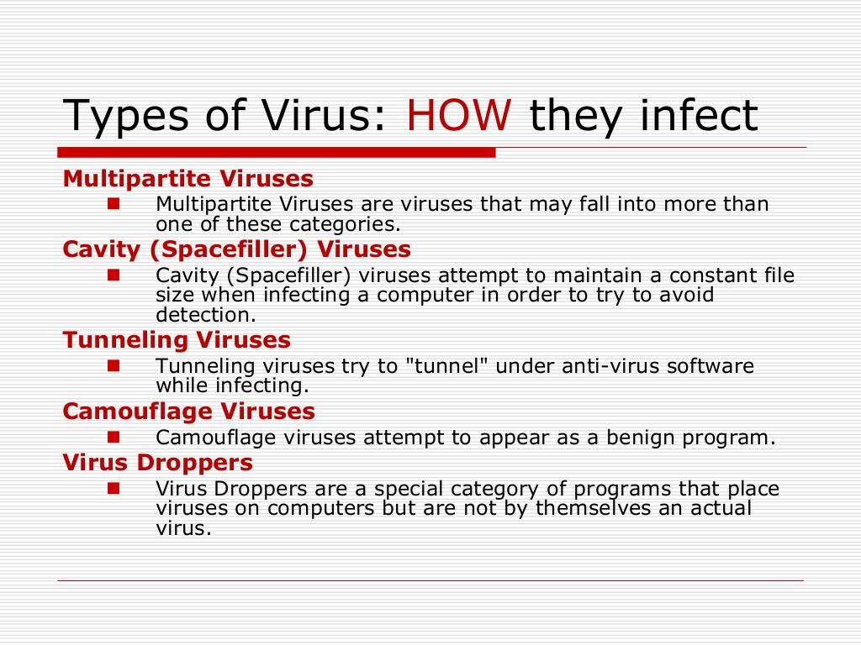
Types of VIRUS : How they infect

Slide 24
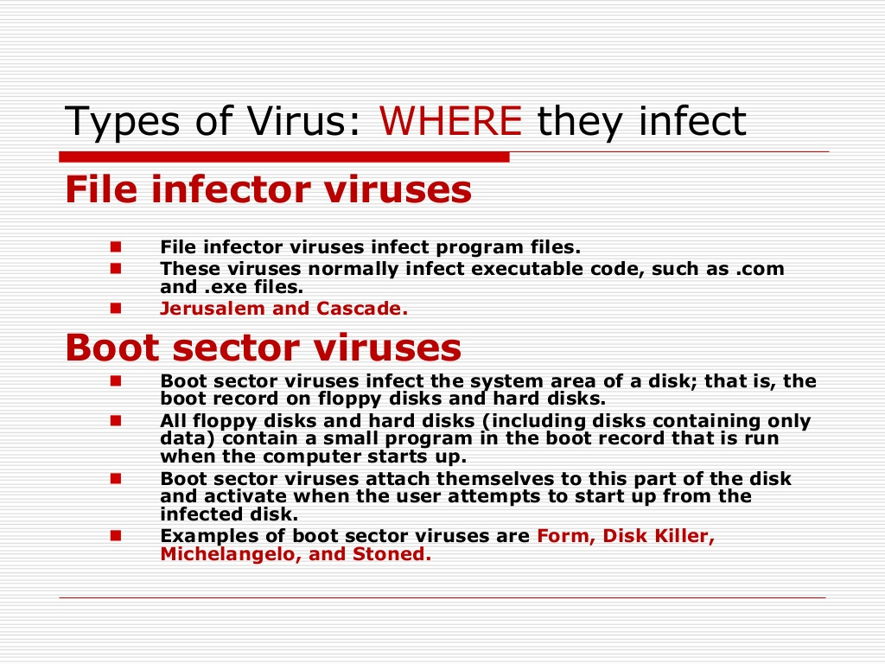
Types of VIRUS : Where they infect

Slide 25
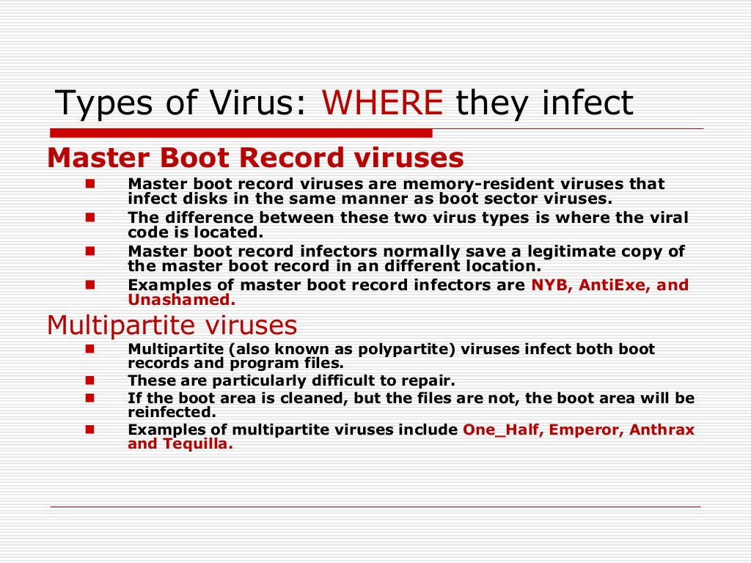
Types of VIRUS : Where they infect

Slide 26
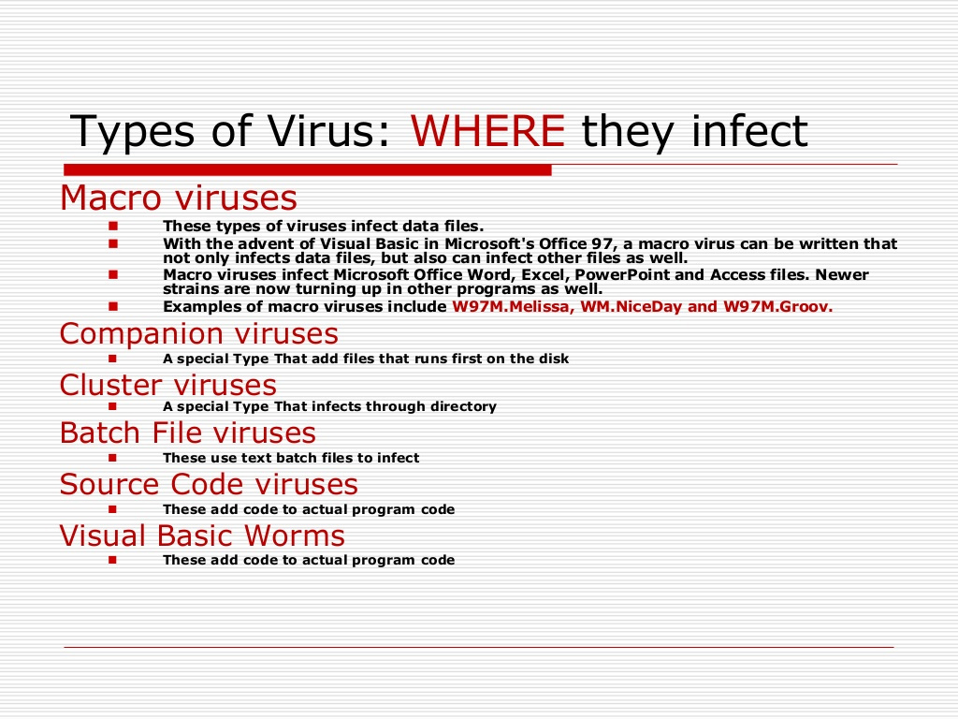
Types of VIRUS : Where they infect

Slide 27
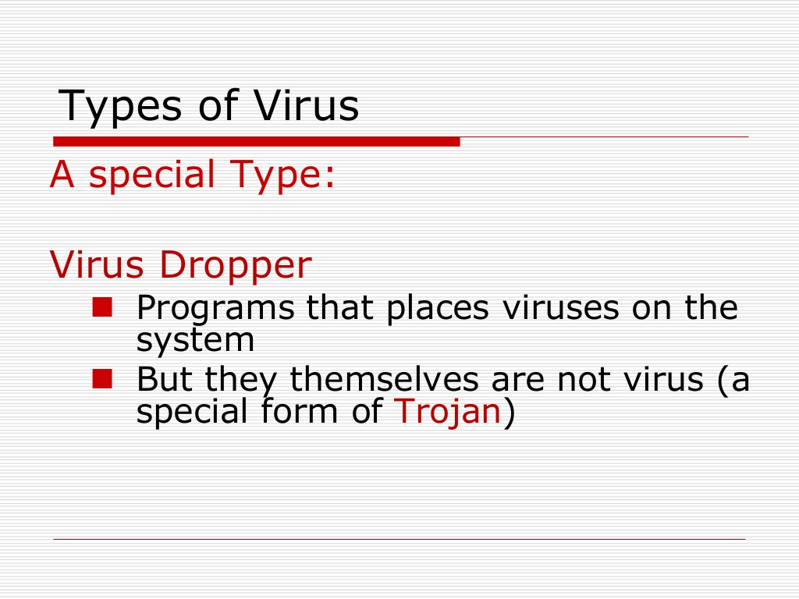
Types of VIRUS

Slide 28
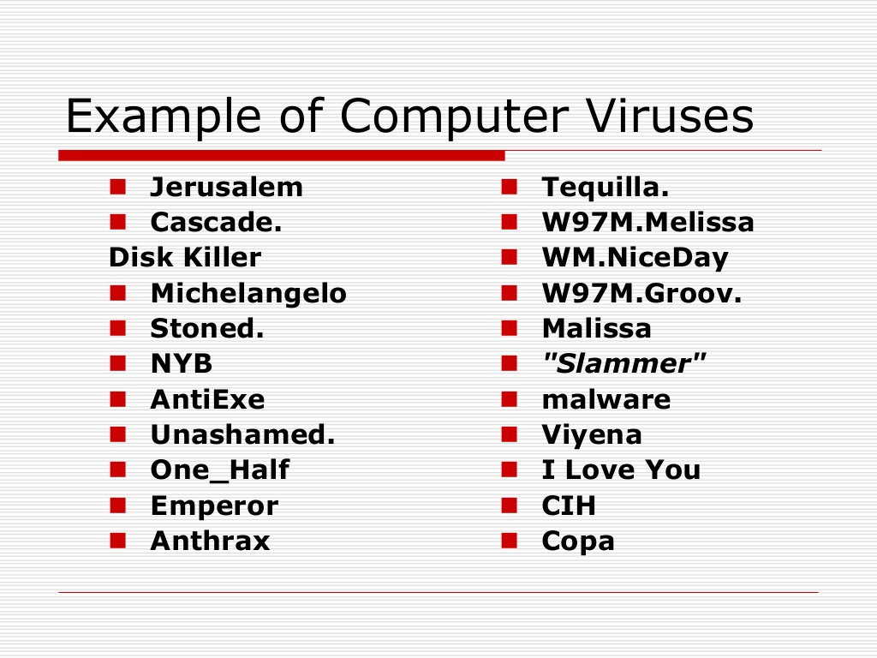
Examples of Computer Virus

Slide 29
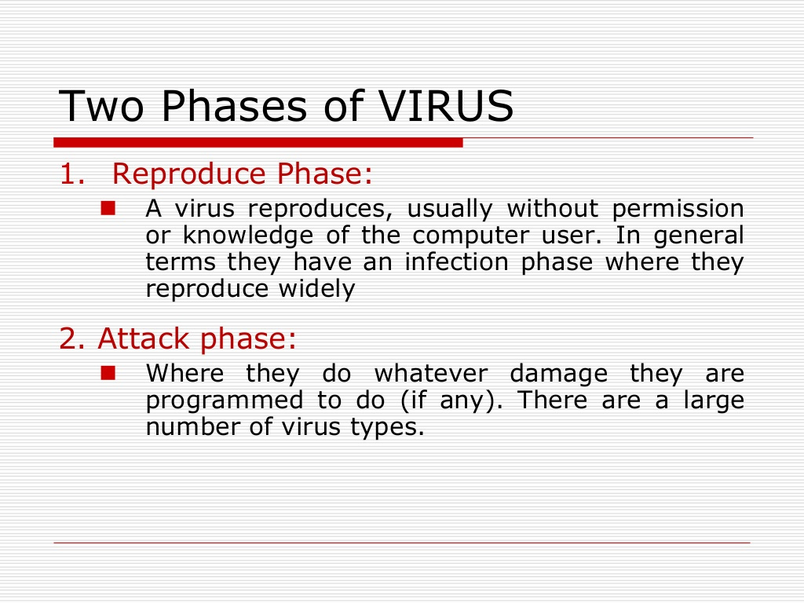
Two Phases of VIRUS

Slide 30
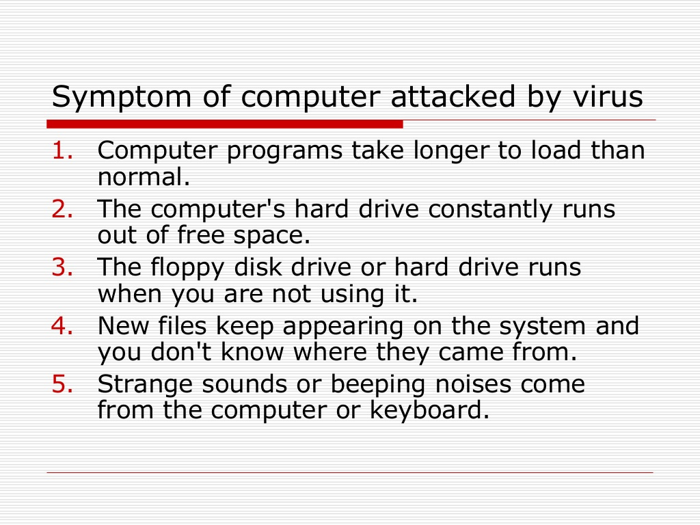
Symptom of Computer attacked by VIRUS

Slide 31
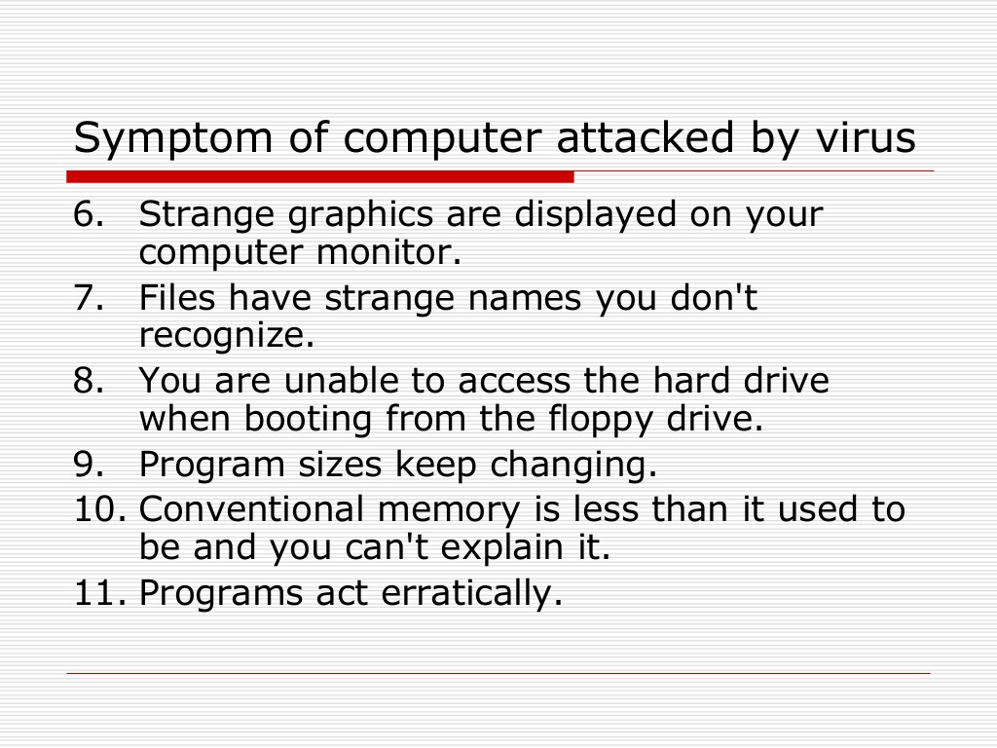
Symptom of Computer attacked by VIRUS

Slide 32
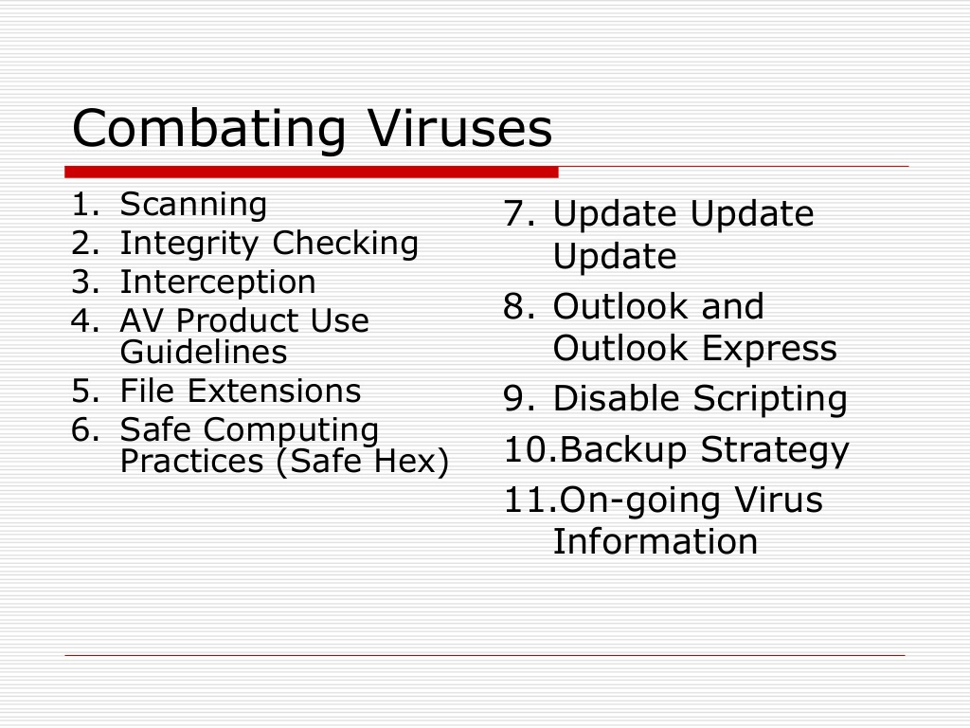
Combatting Viruses

Slide 33
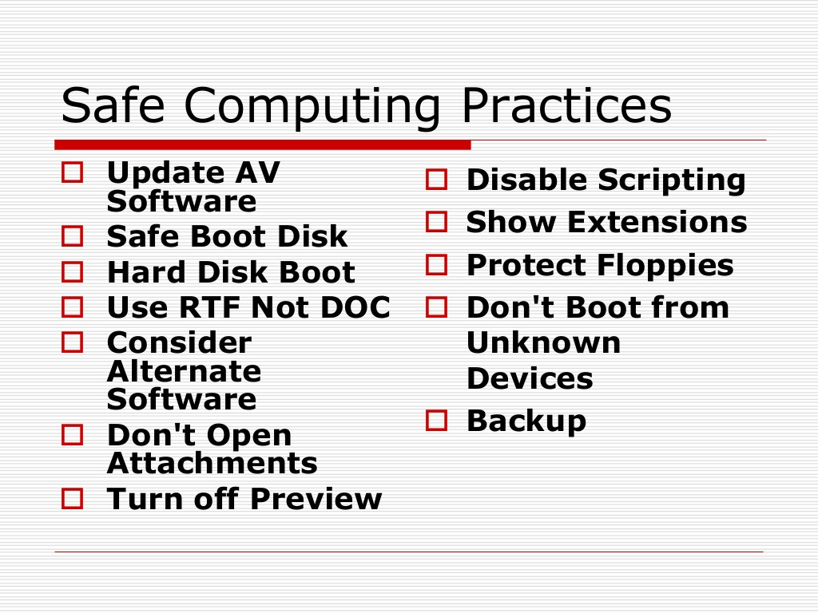
Safe Computing Practices

Slide 34
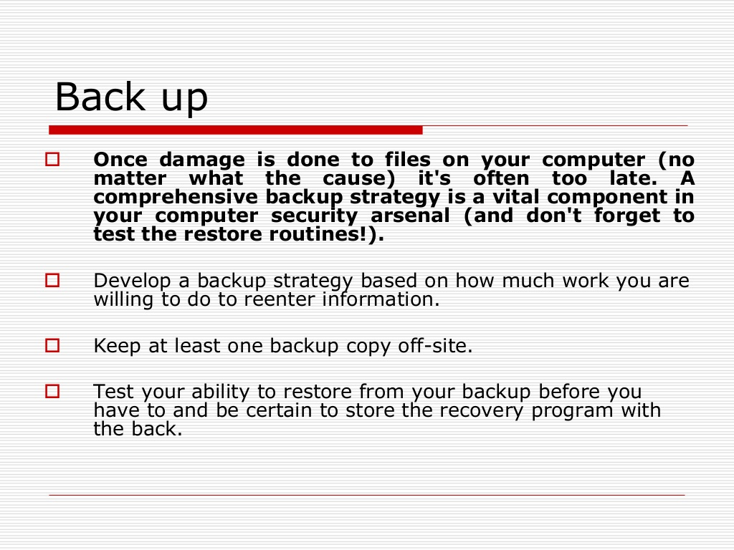
Back Up

Slide 35
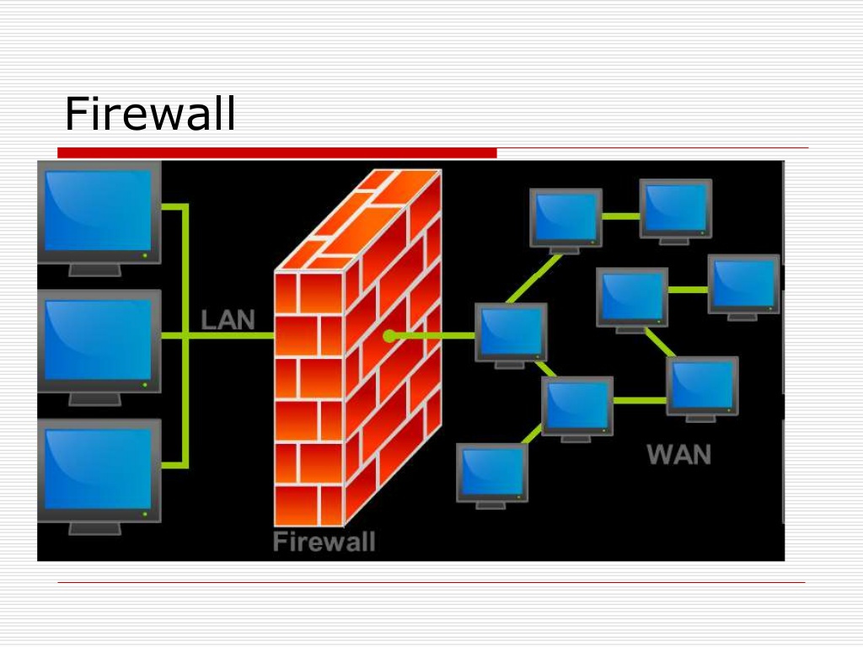
Firewall

Slide 36
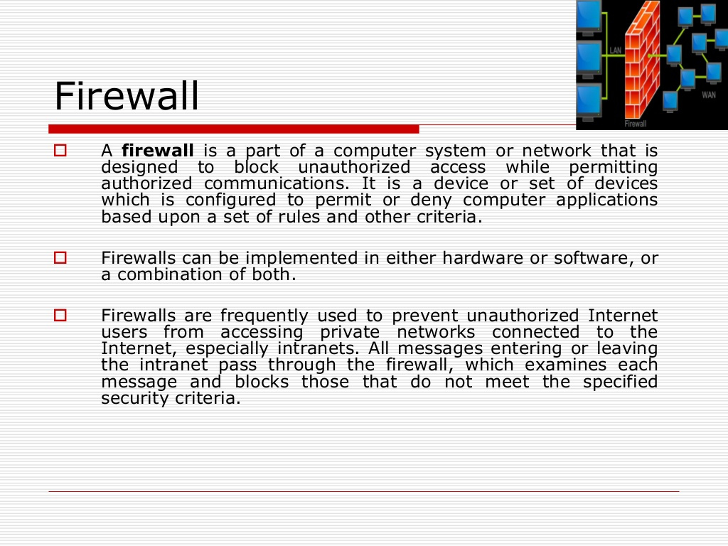
Firewall

Slide 37
Worms
Worm is a malicious program category, exploiting operating system vulnerabilities to spread itself.
In its design, worm is quite similar to a virus - considered even its sub-class. Unlike the viruses though worms can reproduce/ duplicate and spread by itself. During this process worm does not require to attach itself to any existing program or executable. Different types of worms based on their method of spread are email worms; internet worms; network worms and multi-vector worms.

Slide 38
Types of Worms
The most common categorization of worms relies on the method how they spread:
Email worms: spread through email messages, especially through those with attachments.
Internet worms: spread directly over the internet by exploiting access to open ports or system vulnerabilities.
Network worms: spread over open and unprotected network shares.
Multi-vector worms: having two or more various spread capabilities.

Slide 39
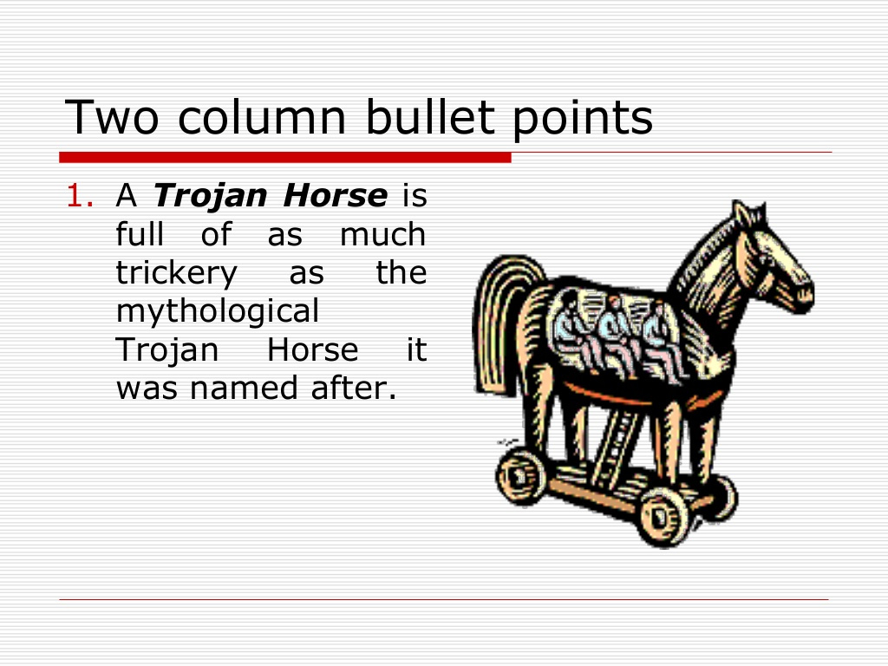
Trojan Horse

Slide 40
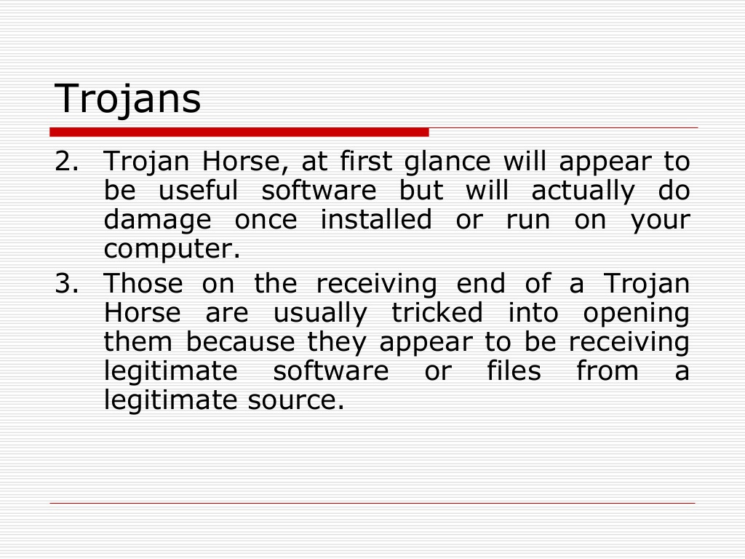
Trojans

Slide 41
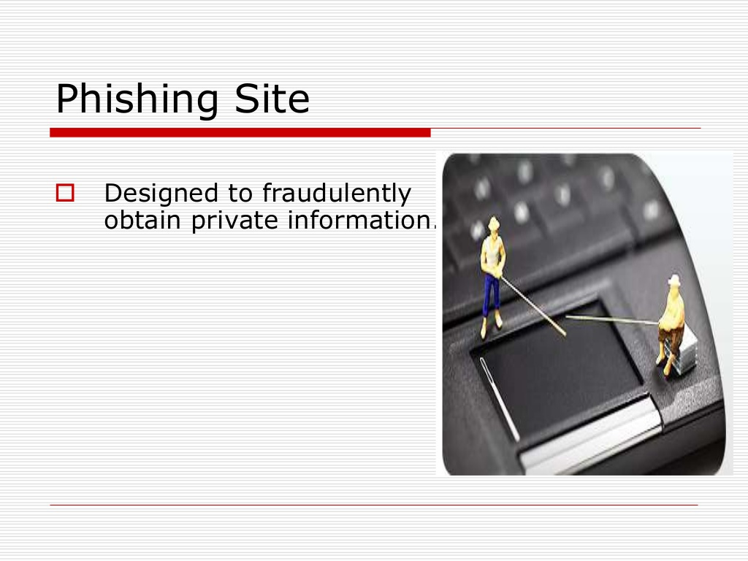
Phishing Site

Slide 42
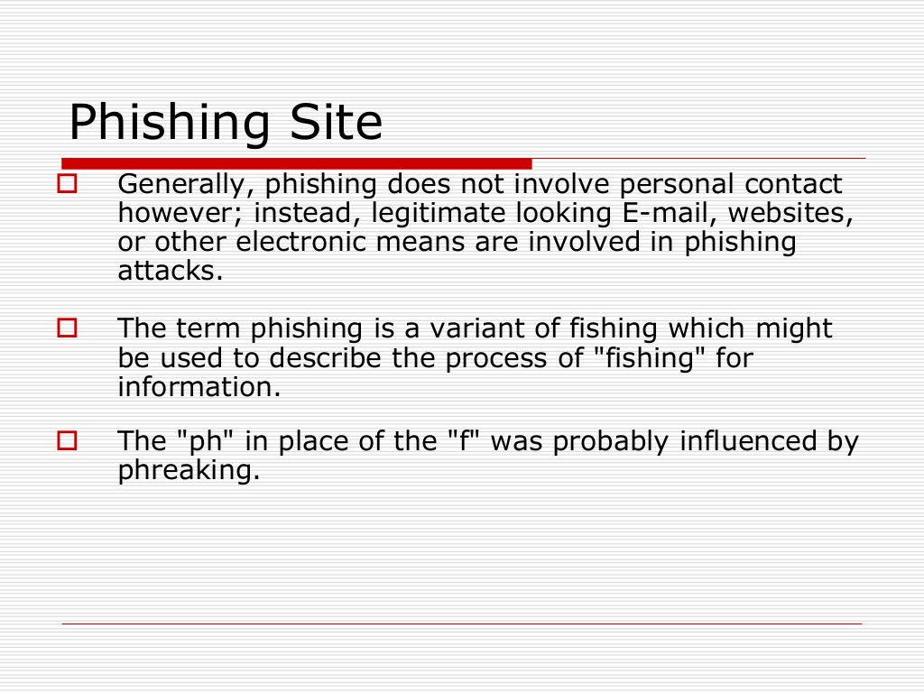
Phishing Site

Slide 43
Trojan Horse
Outline
Computer Trojan or Trojan Horses are named after the mythological Trojan horse owing to their similarity in operation strategy. Trojans are a type of malware software that masquerades itself as a not-malicious even useful application but it will actually do damage to the host computer after its installation. Unlike virus, Trojans do not self-replicate unless end user intervene to install.

Slide 44
Outline
Trojans do not self-replicate since its key difference to a virus and require often end user intervention to install itself - which happens in most scenarios where user is being tricked that the program he is installing is a legitimate one (this is very often connected with social engineering attacks on end users).
email attachment or a link in an email
as a file or link in an instant messaging
drive-by downloads or downloaded and dropped by other Trojans itself or legitimate programs that have been compromised.
low invasive
only change the wallpaper or desktop icons through Trojans which open backdoors on the computer and allow other threats to infect the host or allow a hacker remote access to the targeted computer system
serious damage on the host
by deleting files or destroying the data on the system using various ways (like drive format or causing BSOD). Usually stealthy
Classification
Function based (payload)
The way they breach the system

Slide 45
Outline
Remote Access Trojan (Backdoor):
this type of Trojan opens backdoor on the targeted system to allow the attacker remote access to the system or even complete control over it. This kind of Trojan is most widespread type and often has as well various other functions. It may be used as an entry point for DOS attack or for allowing worms or even other Trojans to the system. A computer with a sophisticated backdoor program installed may also be referred to as a "zombie" or a "bot". A network of such bots may often be referred to as a "botnet". Backdoor. Trojans are generally created by malware authors who are organized and aim to make money out of their efforts. These types of Trojans can be highly sophisticated and can require more work to implement than some of the simpler malware seen on the Internet
Trojan-DDoS - this Trojan is installed simultaneously on a large number of computers in order to create a zombie network (botnet) of machines that can be used (as attackers) in a DDoS attack on a particular target.
Destructive Trojan – this is designed to destroy or delete data. It is much like a virus.

Slide 46
Outline
Trojan-FTP – this Trojan is designed to open FTP ports on the targeted machine allow remote attacker access to the host. Furthermore, the attacked can access as well network shares or connections to further spread other threats.
Security Software Disabler Trojan – this is designed to stop security programs like antivirus solutions, firewalls or IPS either by disabling them or killing the processes. This kind of Trojan functionality is often combined with destructive Trojan that can execute data deletion or corruption only after the security software is disabled. Security Software Disablers are entry
Trojans that allow next level of attack on the targeted system.

Slide 47
Types
Info Stealer (Data Sending/ Stealing Trojan) - this Trojan is designed to provide attacker with confidential or sensitive information from compromised host and send it to a predefined location (attacker). The stolen data comprise of login details, passwords, PII, credit card information etc.
Data sending Trojans can be designed to look for specific information only or can be more generic like Key-logger Trojans. Nowadays more than ever before attackers are concentrating on compromising end users for financial gain. The information stolen with use of Info stealer Trojan is often sold on the black market. Info stealers gather information by using several techniques.
The most common techniques may include log key strokes, screen shots and web cam images, monitoring internet activity often for specific financial websites. The stolen information may be stored locally so that it can be retrieved later or it can be sent to a remote location where it can be accessed by an attacker. It is often encrypted before posting it to the malware author.
Keylogger Trojan – this is a type of data-sending Trojan that is recording every keystroke of the end user. This kind of Trojan is specifically used to steal sensitive information from targeted host and send it back to attacker. For these Trojans, the goal is to collect as much data as possible without any direct specification what the data will be.

Slide 48
Trojan Horse Types
Trojan-PSW (Password Stealer) – this is a type of data-sending Trojans designed specifically to steal passwords from the targeted systems. In its execution routine, the Trojan will very often first drop a keylogging component onto the infected machine.
Trojan-Banker – a Trojan designed specifically to steal online banking information to allow attacker further access to bank account or credit card information.
Trojan-IM – a type of data-sending Trojan designed specifically to steal data or account information from instant messaging programs like MSN, Skype etc.
Trojan-Game Thief – a Trojan designed to steal information about online gaming account.
Trojan Mail Finder – a Trojan used to harvest any emails found on the infected computer. The email list is being then forwarded to the remote attacker.

Slide 49
Types of Trojan Horse
Trojan-Downloader – a Trojan that can download other malicious programs to the target computer. Very often combined with the functionality of Trojan-Dropper. Most downloaders that are encountered will attempt to download content from the internet rather than the local network. In order to successfully achieve its primary function, a downloader must run on a computer that is inadequately protected and connected to a network. This type of Trojan can be either targeted to extort money for "non-existing" threat removal or in other cases the installation of the program itself injects other malware to the host machine.
FakeAV applications can perform fake scans with variable results, but always detect at least one malicious object. They may as well drop files that are then ‘detected’. The FakeAV application is constantly updated with new interfaces so that they mimic the legitimate anti-virus solutions and appear very professional to the end users.

Slide 50
Trojan Horse
Trojan-Spy – this Trojan has a similar functionality to the Info stealer or Trojan-PSW and its purpose is to spy on the actions executed on the target host. These can include tracking data entered via keystrokes, collecting screenshots, listing active processes/ services on the host or stealing passwords.
Trojan-Clicker or Trojan-AD clicker – a Trojan that continuously attempts to connect to specific websites in order to boost the visit counters on those sites. More specific functionality of the
Trojan can include generating traffic to pay-per-click web advertising campaigns in order to create or boost revenue.
Trojan-SMS – a Trojan used to send text messages from infected mobile devices to premium rate paid phone numbers.

Slide 51
Types of Trojan Horse
Cryptolock Trojan (Trojan.Cryptolocker) – this is a new variation of Ransomware Trojan emerged in 2013, in a difference to a Ransomlock Trojan (that only locks computer screen or some part of computer functionality), the Cryptolock Trojan encrypts and locks individual files.
While the Cryptolocker uses a common Trojan spreading techniques like spam email and social engineering in order to infect victims, the threat itself uses more sophisticated techniques likes public-key cryptography with strong RSA 2048 encryption.

Slide 52
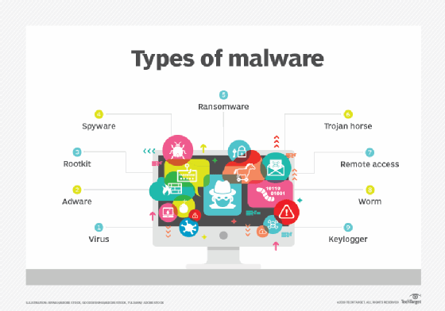
Other Security Threats

Slide 53
Network Attacks
Network attack is usually defined as an intrusion on the network infrastructure that will first analyse the environment and collect information in order to exploit the existing open ports or vulnerabilities. This may include unauthorized access to organisation resources.
Characteristics of network attacks:
Passive attacks: they refer to attack where the purpose is only to learn and get some information from the system, but the system resources are not altered or disabled in any way.
Active attacks: in this type of network attack, the perpetrator accesses and either alters, disables or destroys resources or data.
Outside attack: when attack is performed from outside of the organization by unauthorized entity it is said to be an outside attack.
Inside attack: if an attack is performed from within the company by an "insider" that already has certain access to the network it is considered to be an inside attack.
Others such as end users targeted attacks (like phishing or social engineering): these attacks are not directly referred to as network attacks, but are important to know due to their widespread occurrences.

Slide 54
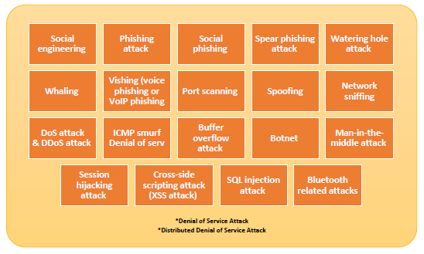
Network Attacks

Slide 55
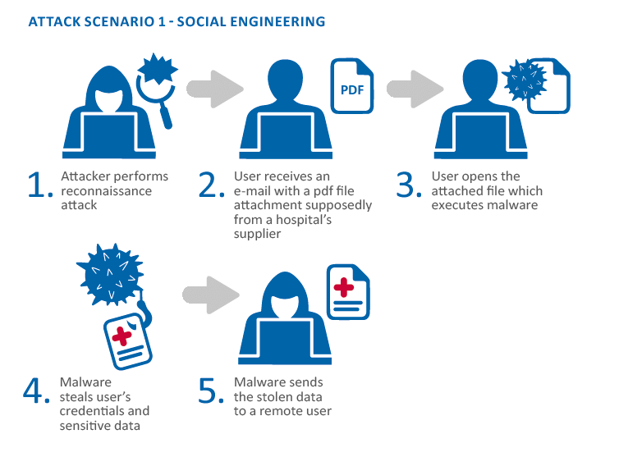
Social Engineering

Slide 56
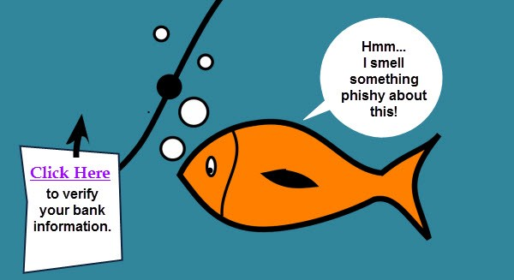
Phishing Attack
CEO Fraud (Business Email Compromise)
Clone Phishing
Domain Spoofing
Evil Twin
HTTPS Phishing
Smishing
Spear Phishing
Vishing
Watering Hole phishing
Whaling
https://www.thesslstore.com/blog/10-types-of-phishing-attacks-and-phishing-scams/

Slide 57
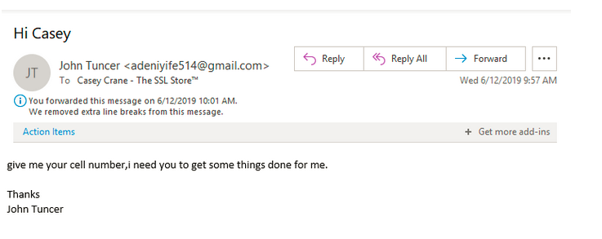

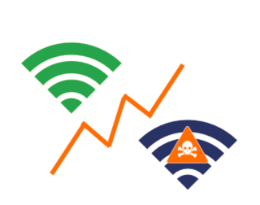

Phishing Attack

Slide 58
Phishing Attack Security
1. Never open or download a file from an unsolicited email, even from someone you know
(you can call or email the person to double check that it really came from them).
2. Keep your operating system updated.
3. Use a reputable anti-virus program.
4. Enable two factor authentication whenever available.
5. Confirm the authenticity of a website prior to entering login credentials by looking for a
reputable security trust mark.
6. Look for HTTPS in the address bar when you enter any sensitive personal information on a
website to make sure your data will be encrypted.

Slide 59
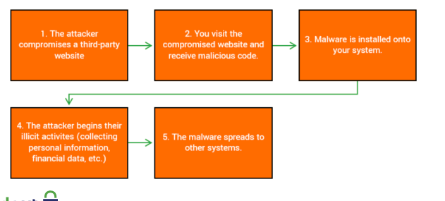
Phishing Attack – watering hole Attack

Slide 60
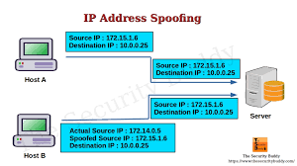
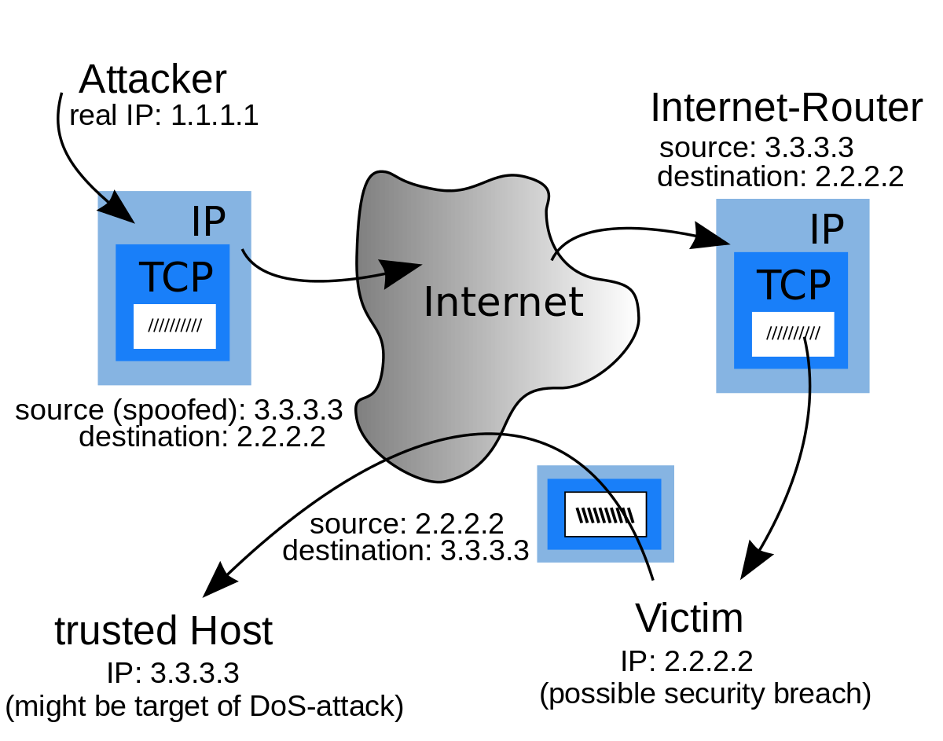
Spoofing
it is a technique used to masquerade a person, program or an address as another by falsifying the data with purpose of unauthorized access.

Slide 61
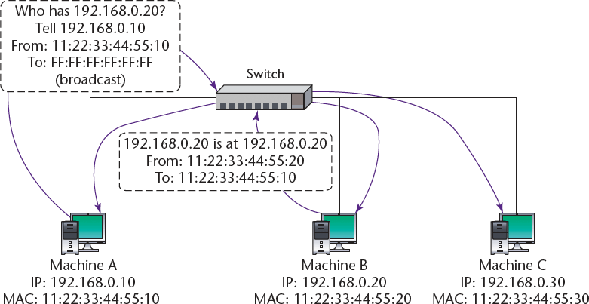
ARP Spoofing ARP Poisoning

Slide 62
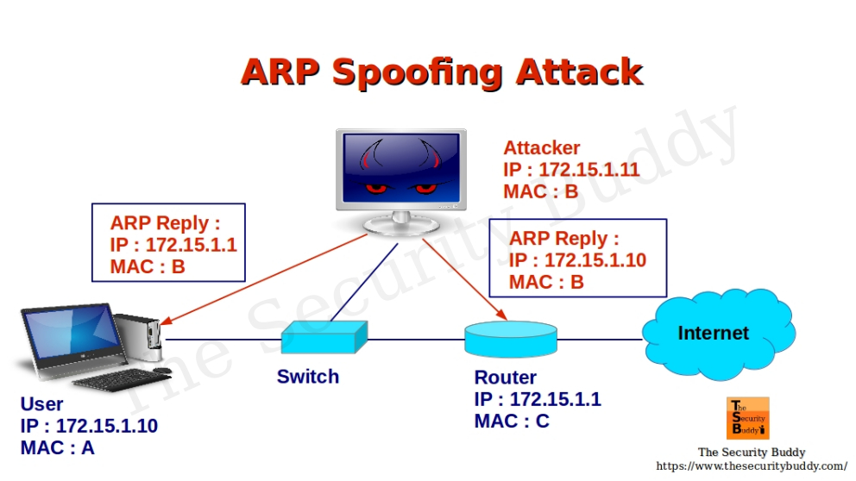
ARP Spoofing ARP Poisoning

Slide 63
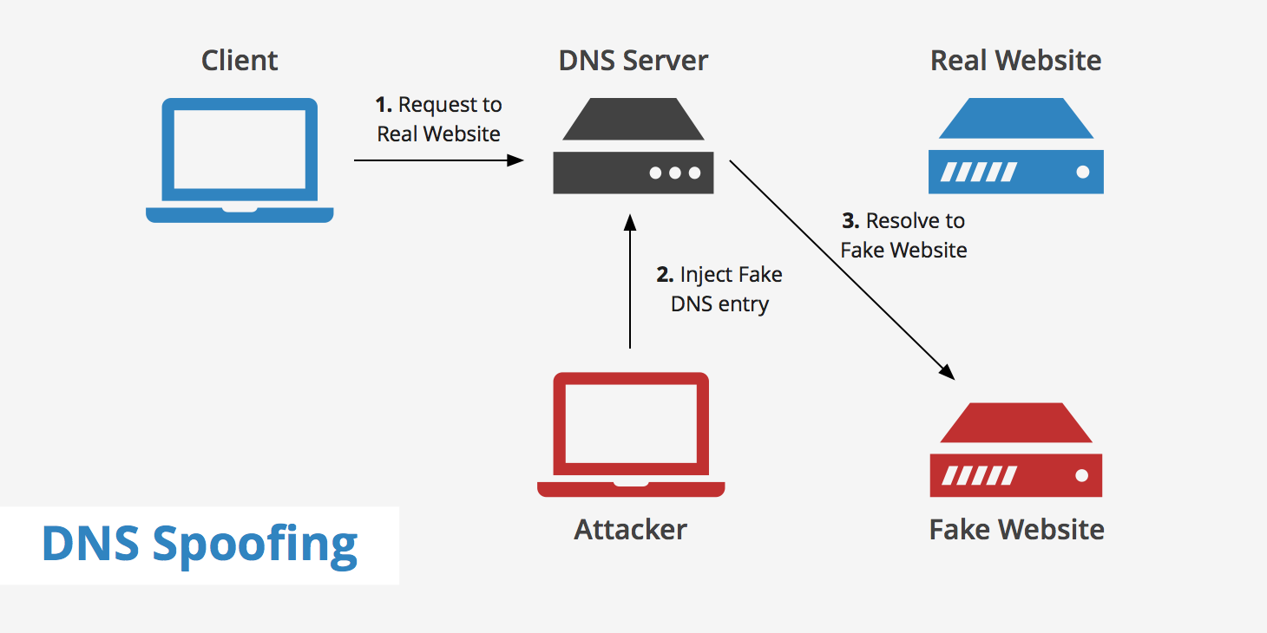
DNS Spoofing DNS Cache Poisoning

Slide 64
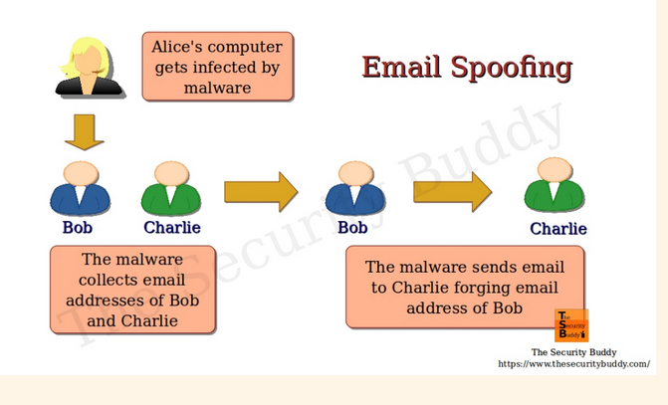
Email Spoofing

Slide 65
Denial of Service (DoS) Distributed DoS
an attack designed to cause an interruption or suspension of services of a specific host/ server by flooding it with large quantities of useless traffic or external communication requests. When the DoS attack succeeds the server is not able to answer even to legitimate requests anymore, this can be observed in numbers of ways – slow response of the server, slow network performance, unavailability of software or web page, inability to access data, website or other resources. Distributed Denial of Service Attack (DDoS) occurs where multiple compromised or infected systems (botnet) flood a particular host with traffic simultaneously.

Slide 66
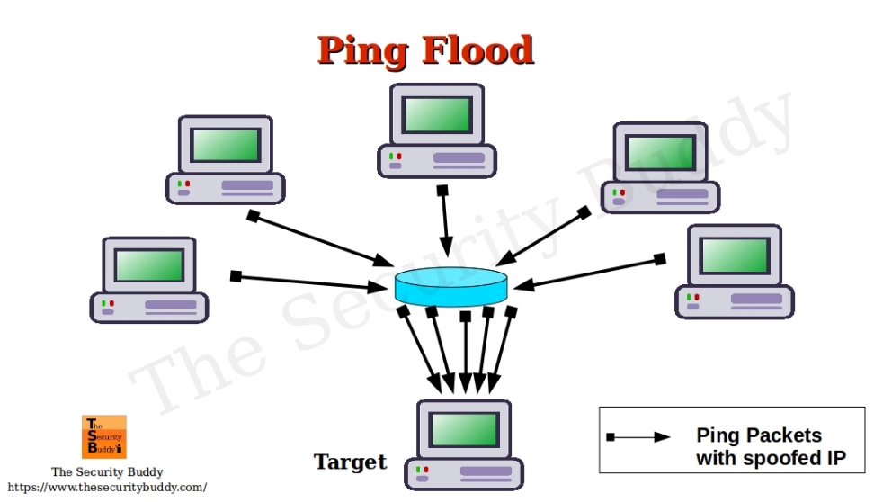
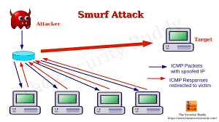
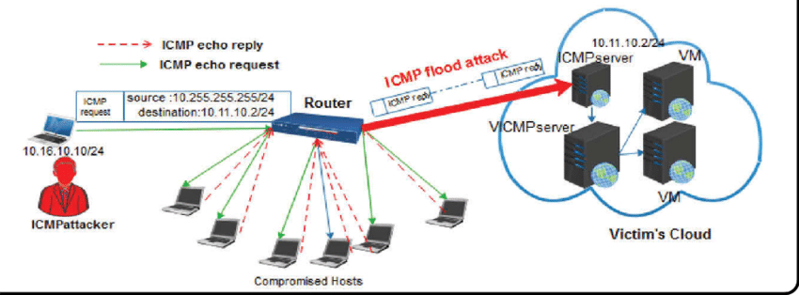
DoS – ICMP Flood –Ping Flood

Slide 67
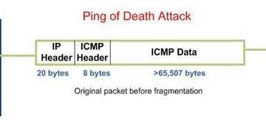
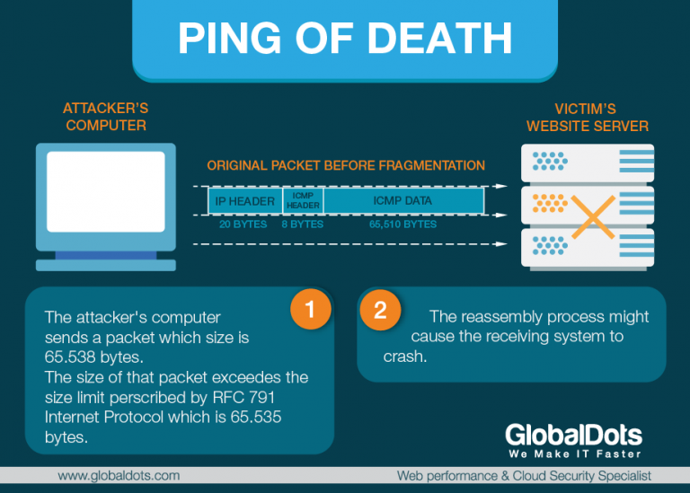
DoS – Ping of Death

Slide 68
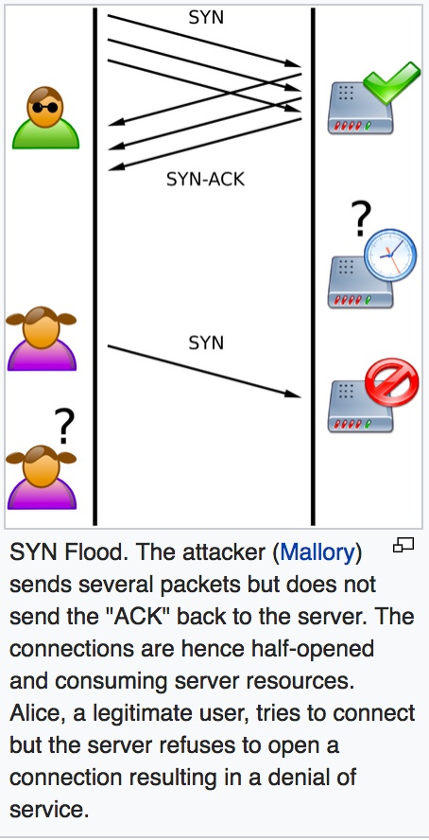
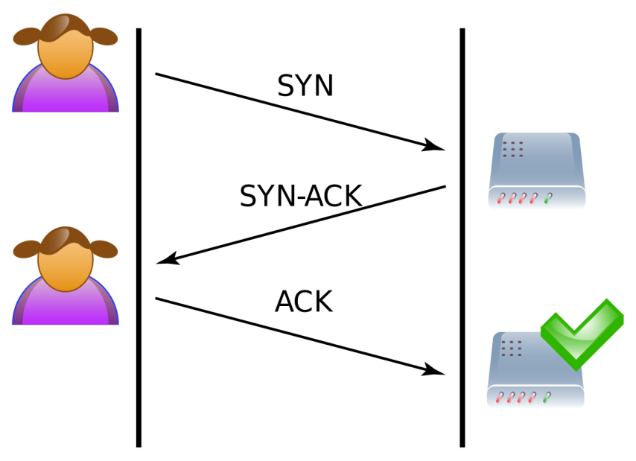
DoS – SYN Flood Attack

Slide 69
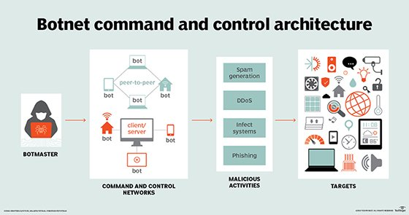
DoS – Botnet

Slide 70
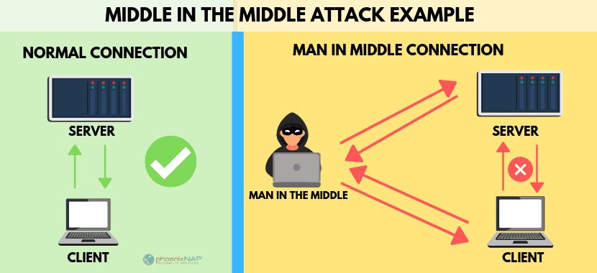
Man in the Middle Attack

Slide 71
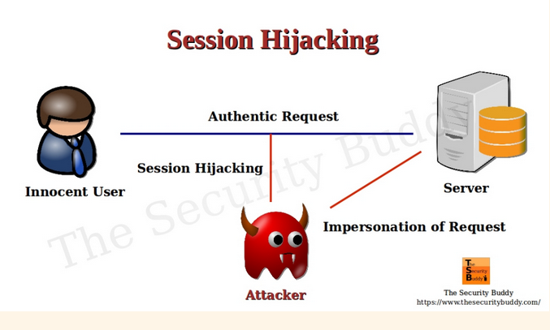
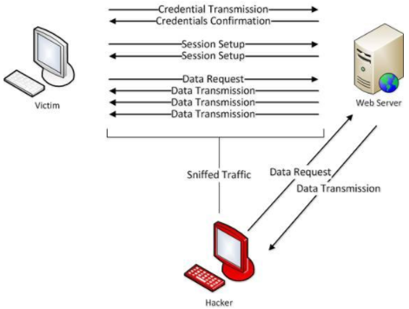
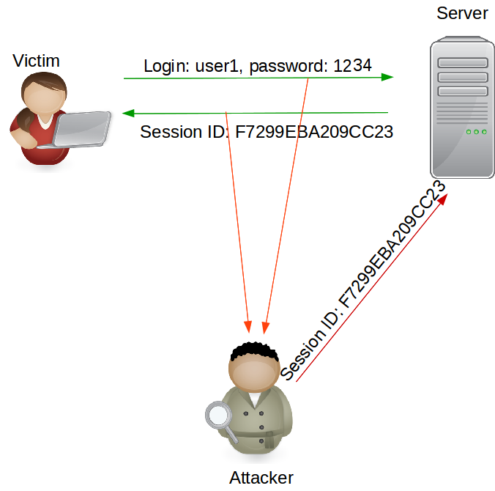
Session Hijacking

Slide 72

Cross Site Scripting

Slide 73

SQL Injection Attack

Slide 74



BlueTooth Attacks

Slide 75

Top Network Attacks

